Slide 1
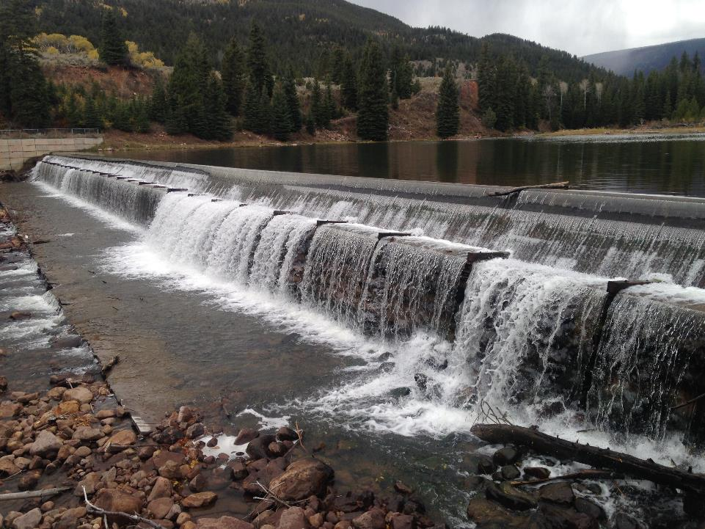
American society of mining and reclamation big sky, mt 06/04/2019
Yellowstone hydroelectric decommissioning project
duchesne county, utah

Slide 2
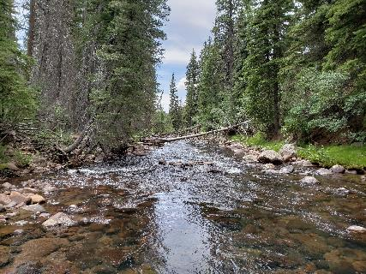
American society of mining and reclamation big sky, mt June 4 2019
Project Background
FERC and Planning Process
Stream Assessment Methods
Site Conditions and Functional Attributes
Stream Restoration Design Process
Example Treatments
Summary
Notes:
Discussion Topics

Slide 3
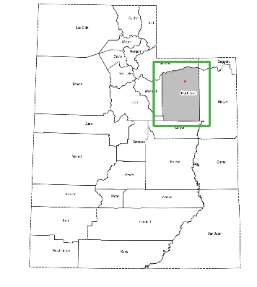
Project background
American society of mining and reclamation big sky mt, 2019
This Project is in the Yellowstone River… But…
NOT Located in Yellowstone National Park
NOT in Montana
Ashley National Forest
Duchesne County, Utah

Slide 4
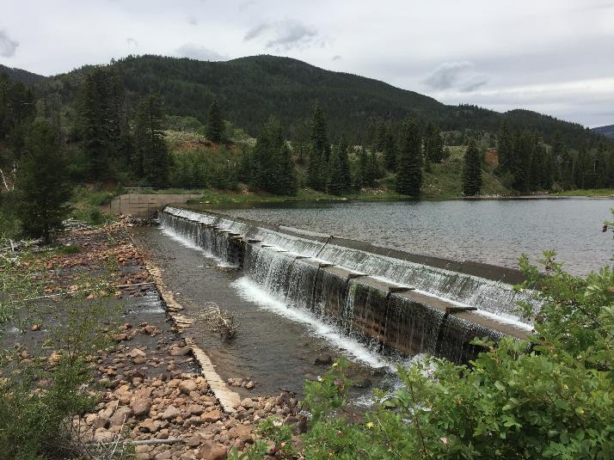
Project background
American society of mining and reclamation big sky, mt 2019
Notes:
Moon Lake Electric Association, Inc. (Moon Lake), is applying to the Federal Energy Regulatory Commission (FERC) for a surrender of license for the Yellowstone Hydroelectric Project.
Originally licensed in 1943, the small hydroelectric company has been in production for 77 years.
Based on findings during the relicensing process, a determination was made that the costs to operate and repair infrastructure, in addition to the low power generation, it is in the best interest of Moon Lake to decommission the project and to satisfy their customers from other sources of power.
The costs associated with the replacement of the penstock and renewing the existing license would significantly increase the cost of power from the Yellowstone Hydroelectric project.
There are less expensive sources in the Uinta Basin produced from Oil and Gas extracted from the Williams Fork Formation.

Slide 5
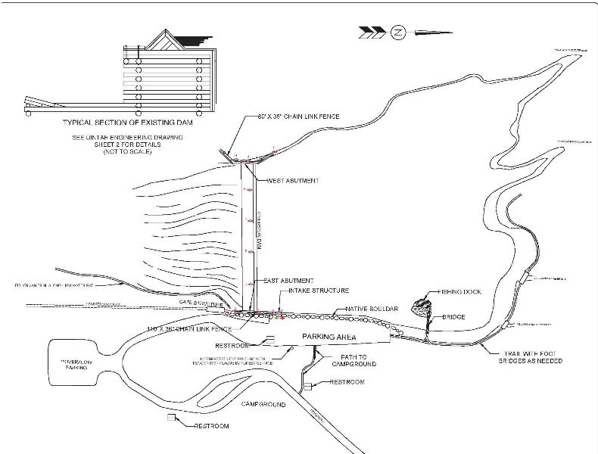
American society of mining and reclamation big sky, mt 2019
Notes:
The Dam is 4.6 meter-high vertical drop, 113-meter long timber, rock, and steel composite dam that impounds a small 3.8 acre reservoir.
A 4,307-meter long penstock pipeline runs along the upland terrace to a powerhouse facility with a capacity of 900 kilowatts.
Sluice gate structure, where sediments have been historically sluiced to restore reservoir capacity.

Slide 6
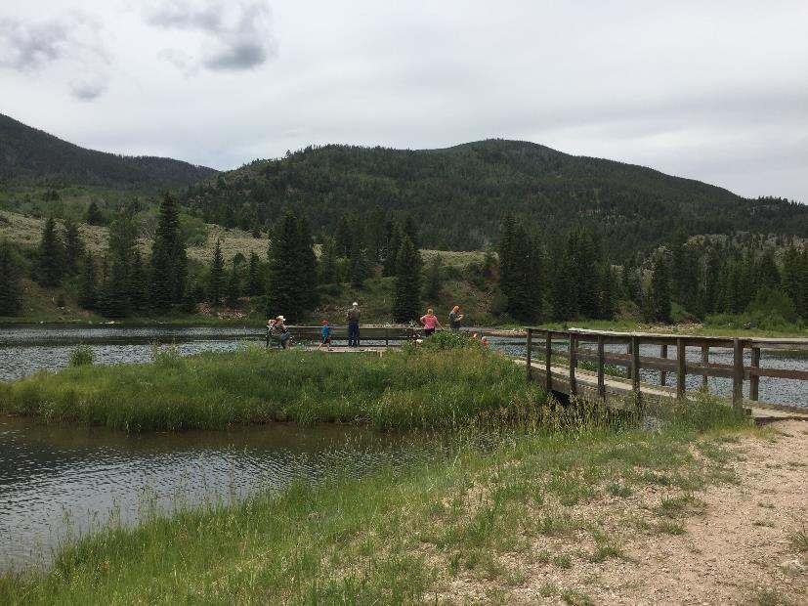
American society of mining and reclamation big sky, mt 2019
Notes:
The Reservoir is a popular destination for recreation. The USFS operates a campground, with several designated spaces, restroom facilities, and dayuse parking area.
There is a fishing dock and trails surround the reservoir and creek both upstream and downstream of the reservoir.
Stocked trout
Average length = 10 inch

Slide 7
FERC and planning process
American society of mining and reclamation big sky, mt 2019
Federal Energy Regulatory Commission
Surrender of License
Dam and Public Safety
Environmental Resources
Licensee is responsible for restoration
if project is on federal lands
NEPA Environmental Assessment
NHPA Class III Cultural Resources Survey
Notes:
FERC’s surrender of license application requires the following elements:
National Environmental Policy Act (NEPA) documentation
Dam Decommissioning and Sediment Removal Plan
Stream Restoration and Site Reclamation Plans
Long-term Monitoring and Success Criteria
USFS/MLEA Documentation and “Quit Claim of Easement” gives back management of lands to USFS.
Project Stakeholders (MLEA, USFS, Landowners, TU, DWR)

Slide 8
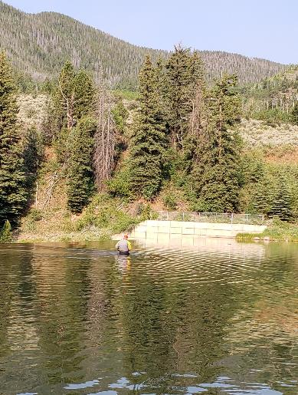

Site assessment methods
American society of mining and reclamation big sky, mt 2019
Topographic Survey
  Reservoir Bathymetry
  Floodplain, Springs, Wetlands
  Roadway and Campground
  Diversion and Penstock
Geomorphic Survey
  Cross sections
  Longitudinal Profiles
  Bank Stability
  Large Wood
  Sediment Gradation
Reservoir Sediments
  Several Core Samples
  Laboratory Testing (chemical and physical)
Aquatic Surveys
Biological Surveys
Cultural Surveys
Notes:
Our collective team performed a site assessment:
Bathymetric and Topographic surveys
Geomorphic assessment—methods follow Rosgen and stream assessment tools to evaluate stream functions and quantify functional lift
Large Wood Inventory
Sediment assessment – lab test for contaminants and gradation
Biological Surveys
Cultural investigation

Slide 9
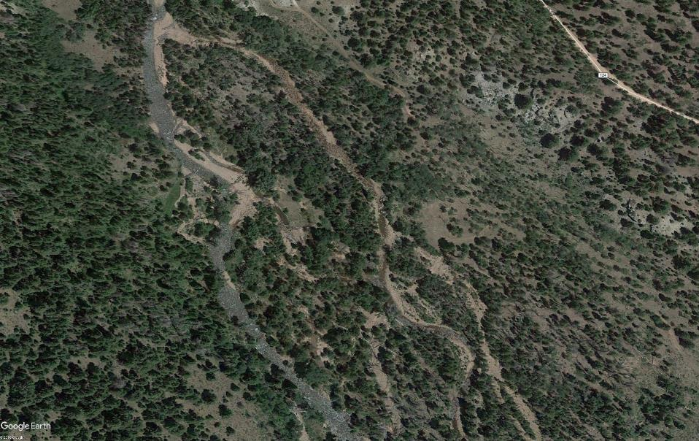
American society of mining and reclamation big sky, mt 2019
Notes:
The Yellowstone River is a multiple thread meandering channel with lateral bars in the tighter valley sections. In the wider valley sections, the channel displays a braided channel character forming mid-channel and side bar deposits, islands, and multiple channels across the floodplain and valley floor. The valley floor consists of alluvium, where the channels cut through unconsolidated deposits of sand/gravel/cobbles that have been transported to and deposited on the valley floor and floodplain through fluvial processes. The river generally has single thread main channel, where it can concentrate stream flow and maximize bed-sediment transport; however the Yellowstone River forms multiple channels where the channel is constricted by naturally armored and well vegetated banks, causing deposition and natural channel avulsion.

Slide 10
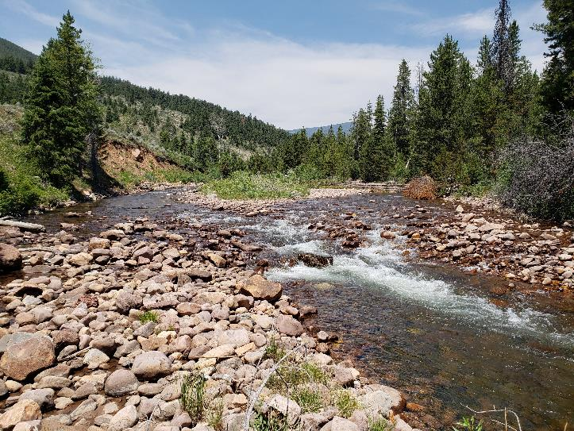
Site conditions and functional attributes
American society of mining and reclamation big sky, mt 2019
Notes:
Sediment supply is driven from both upstream loading primarily supplied to the system from the colluvium slopes and from within the channels themselves.
Yellowstone River does not display well-formed point bars but more lateral bars, a characteristic of steeper coarse substrate alluvial channels that have a lower sinuosity and meander belt width ratio versus wider valleys with shallower slopes. The medial bars and local braided channel characteristics are typical for low sinuosity channels with steep energy gradients and high flood discharges to transport material but also very low discharges, where those deposits divide flow at low stages.
It is a Flood dominated system with High Bedload
Yellowstone River is in a transitional zone within the Valley, where some energy is expended through lateral migration but is predominantly expended through both the boundary roughness in the vertical dimension and the formation of riffles and pools.
Naturally steep riffles and moderate depth pools

Slide 11
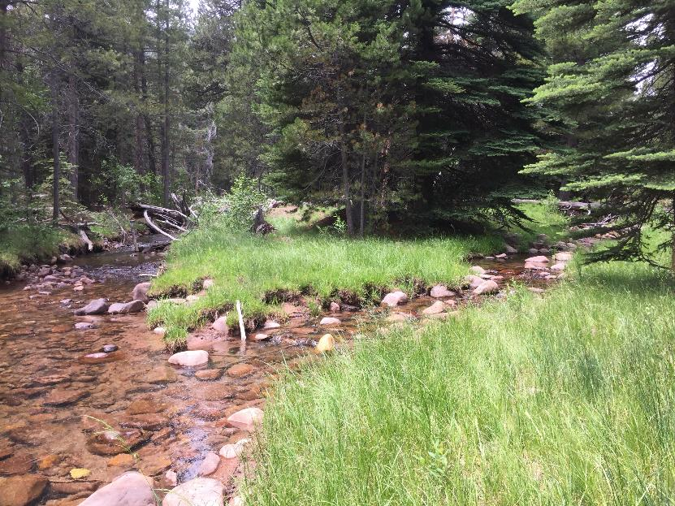
American society of mining and reclamation big sky, mt 2019
Notes:
Side channels and fringe habitats had higher concentration of fish populations than the main channel. Important fisheries rearing habitats.

Slide 12
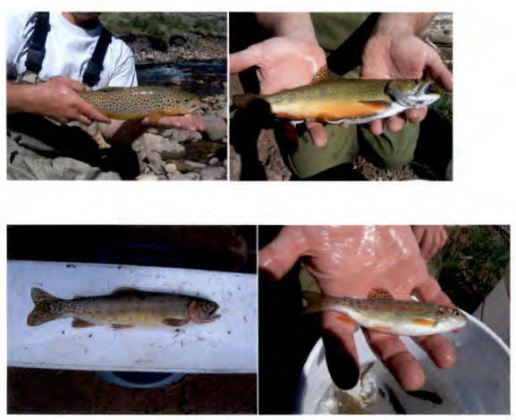
American society of mining and reclamation big sky, mt 2019
Brown Trout
Brook Trout
Rainbow Trout
Cutthroat Trout
Mountain Sucker
Mountain Whitefish
Mottled Sculpin
Notes:
Predominately native fisheries. Recognized as a productive fishery and popular sport fishery destination

Slide 13
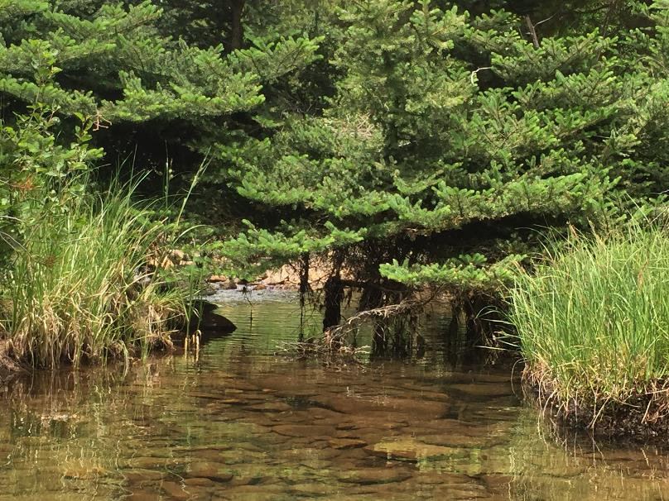
American society of mining and reclamation big sky, mt June 4 2019
Notes:
Springs fed side channels and wetland habitats are throughout the valley floor.

Slide 14
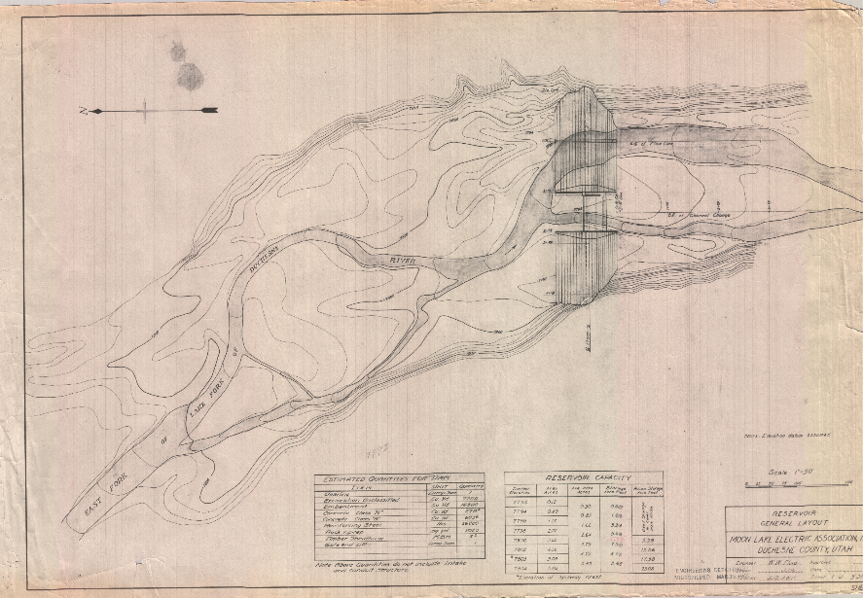
American society of mining and reclamation big sky, mt 2019
Notes:
Historic foot print is a main channel with side channels.

Slide 15
American society of mining and reclamation Big sky, mt June 4 2019
Notes:
This underlying image shows best fit historic channel alignment. See how the current side channel was the main channel. This historic side channel is now current main channel.

Slide 16
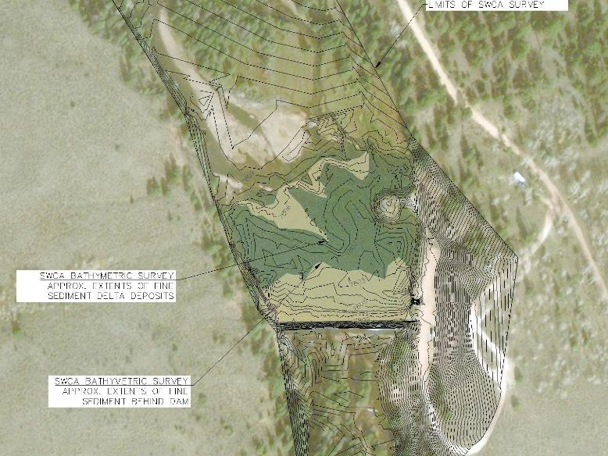
American society of mining and reclamation big sky, mt June 4 2019
Notes:
Bathymetric contours were overlaid onto the original drawings to evaluate the depth of sediment to the natural channel bottom.
MLEA, in partnership with the USFS, has periodically sluiced sediments in the past in an effort to both restore reservoir capacity and provide aquatic habitat benefits by releasing spawning gravels and sand size sediments to augment the transport of sediments to downstream “sediment starved” reaches. However, aquatic habitat monitoring reports show that these efforts provided no measurable benefit (Brunson 2010). Sediment management is often the most important and technically challenging environmental consideration for a dam decommissioning project and can represent a significant portion of the total project cost (USSD 2015). Significant impacts may result from the release of impounded sediments and necessitate mitigation, which could significantly increase the costs for the decommissioning of the Yellowstone Hydroelectric Project. Due to the extents of the fine sediment deposits there is potential to cause negative impacts to aquatic resources. Past studies have shown that the rapid fine-sediment released downstream of reservoirs infiltrates into the larger interstitial spaces at gravel deposits at a shallow depth within the channel bed (Downs et al. 2009) creating a “hard pan” affect. . , and these consequences are not worth the potential spectated benefits to follow past management practices and sluice sediments stored behind the dam. The restoration approach minimizes the potential “hard pan” impact by mechanically removing and relocating the majority of reservoir fine sediments to upland areas.

Slide 17
Reference conditions
American society of mining and reclamation Big sky, mt June 4 2019
Stream Parameter | Reference Conditions | 60% Main Channel Design | 60% Side Channel Design
Average bankfull cross-sectional area (Abkf) | 135 | 125 | 20
Reach slope (feet/feet) | 0.021 | 0.017 | 0.021
Average riffle bankfull width (Wbkf) | 62.1 | 64.2 | 22.4
Average riffle bankfull depth (Dbkf) | 2.23 | 1.95 | 0.90
Width/depth ratio (Wbfk/Dbkf) | 27.5 | 33 | 25
Average riffle length (feet) | 118.5 | 120 | 46
Average riffle slope (feet/feet) | 0.04 | 0.065 | 0.043
Average pool spacing (feet) | 289 | 331 | 98
Average max pool depth (feet) | 5.2 | 5.4 | 2.5
Average pool length (feet) | 168 | 173 | 51
Sinuosity (feet/feet) | 1.14 | 1.11 | 1.1
Radius of curvature range (feet) | 190–338 | 160–208 | 95–111
Notes:
Hydrology study – gage station analysis
Bankfull measured in field and calibrated by gage station analysis. No regional curves were developed because there was good data.
Geomorphic survey established reference parameters to develop stable channel dimension, pattern, and profile.

Slide 18
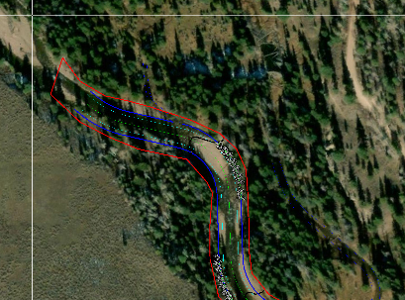
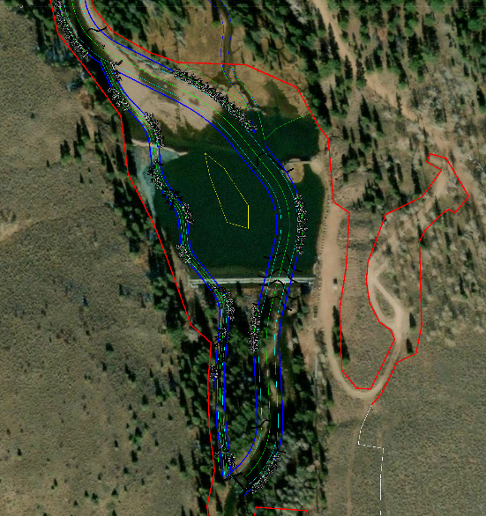
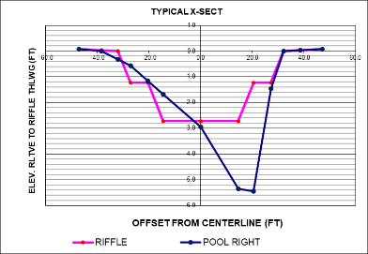
American Society of mining and reclamation Big sky, mt June 4 2019
Notes:
WBKF = 64.2
Riffle Max Depth = 2.72
Pool Max Depth = 5.4

Slide 19
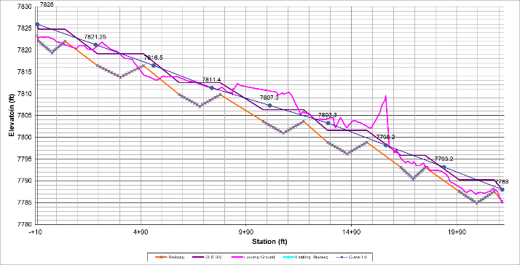
DESIGN CONSIDERATIONS
American Society of Mining and Reclamation Big Sky, MT June 4 2019
Bankfull velocity <5 fps
No drops more than 0.5 fps
Pool depths min. 3’ at base flow.
Notes:
Restored historic profile.

Slide 20
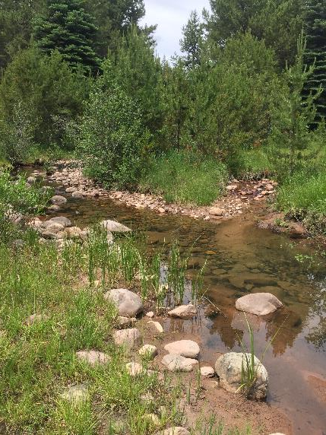
DESIGN CONSIDERATIONS
American Society of Mining and Reclamation Big Sky, MT June 4 2019
Wetland Fringe Habitats at Mouth of Reservoir
Historic Side Channel Habitats
Notes:
A primary goal is to restore the historic foot print and to include a side channel. Restoration of side channel emphasized by Division of Wildlife, USFS, and TU. This increases initial risk for stability and design challenges. Reduced future potential for a channel avulsion by hardening the head of the restored island, and design elevations to reduce shear stress across floodplain and within side channel.
Spring fed wetlands and the wetland fringe habitats at the head of the reservoir and mouth were important aspects to preserve. Main channel aligned to hold a higher elevational head and continue to support the elevated groundwater (hyporheic zone at north end).

Slide 21
American Society of Mining and Reclamation Big Sky, MT June 4 2019
Notes:
NCD
Restores historic pattern and profile
Dimensions designed for bankfull (dominant discharge) and reduce shear stress across floodplain
Salvage and reuse on-site wood
Salvage ad reuse Dam Timbers (and resale to offset costs)

Slide 22
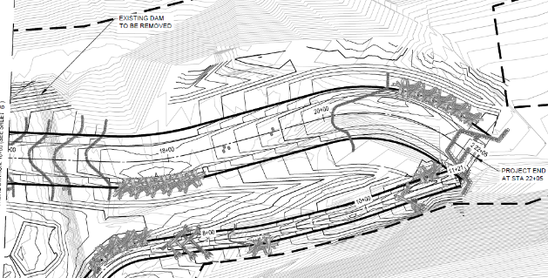
BANK STABILIZATION STRUCTURES
American Society of Mining and Reclamation Big Sky, MT June 4 2019
Wood toe
J-hook
Notes:
FERC’s surrender of license application requires the following elements:
1. National Environmental Policy Act (NEPA) documentation (i.e., an environmental assessment [EA]): An EA does not require multiple alternatives or public scoping.
2. Dam decommissioning and removal plan: Requires review and approval by USFS and FERC’s San Francisco office.
3. Restoration and reclamation plans: Require review and approval by USFS.
4. FERC consultation: FERC consults with Utah State Historic Preservation Office (SHPO) and tribal governments as necessary.
5. MLEA consultation: MLEA coordinates with USFS to obtain a letter of support for the project. Other written coordination with state and federal agencies would support the surrender application.
6. List of adjacent landowners with contact information
7. USFS special use permit or memorandum of agreement: This documentation between USFS and a new owner is required if a transfer of dam ownership will occur.

Slide 23
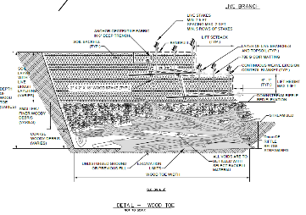
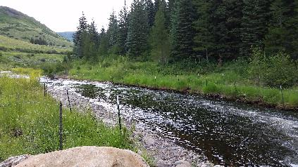
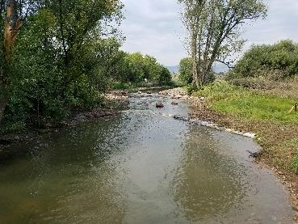
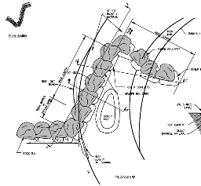
BANK STABILIZATION STRUCTURES
American fisheries society – Co/Wy chapter annual meeting feb 26-28 2019
Notes:
Maximize the use of Wood

Slide 24
Grade control STRUCTURES
American fisheries society – Co/Wy chapter annual meeting feb 26-28 2019
Boulder Constructed Riffle
Boulder Cross Vane with Step (A-Structure)
Log Riffles
Boulder Cluster
Notes:
FERC’s surrender of license application requires the following elements:
1. National Environmental Policy Act (NEPA) documentation (i.e., an environmental assessment [EA]): An EA does not require multiple alternatives or public scoping.
2. Dam decommissioning and removal plan: Requires review and approval by USFS and FERC’s San Francisco office.
3. Restoration and reclamation plans: Require review and approval by USFS.
4. FERC consultation: FERC consults with Utah State Historic Preservation Office (SHPO) and tribal governments as necessary.
5. MLEA consultation: MLEA coordinates with USFS to obtain a letter of support for the project. Other written coordination with state and federal agencies would support the surrender application.
6. List of adjacent landowners with contact information
7. USFS special use permit or memorandum of agreement: This documentation between USFS and a new owner is required if a transfer of dam ownership will occur.

Slide 25
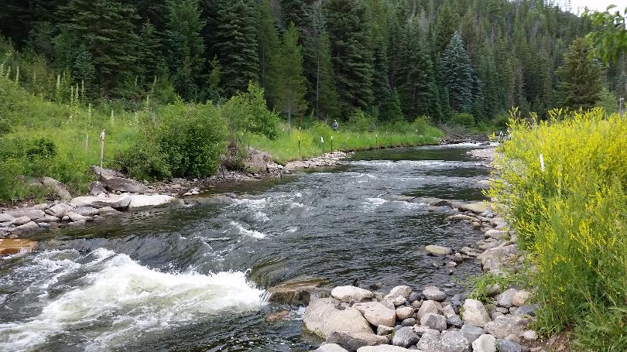
Grade control STRUCTURES
American fisheries society – Co/Wy chapter annual meeting feb 26-28 2019
Boulder Constructed Riffle

Slide 26
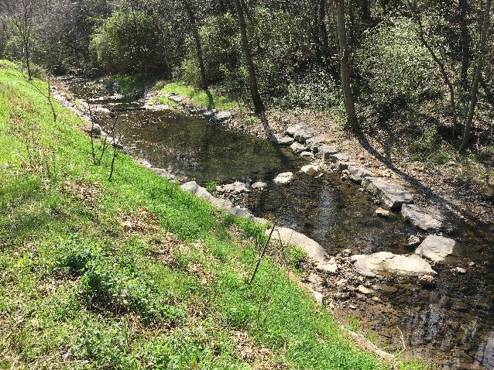
Grade control STRUCTURES
American fisheries society – Co/Wy chapter annual meeting feb 26-28 2019
Boulder A-Structure
Notes:
Steep drops – reduce head

Slide 27
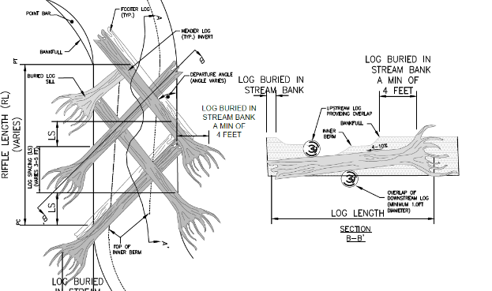
Side Channel Grade control STRUCTURES
American fisheries society – Co/Wy chapter annual meeting feb 26-28 2019
Log Riffles

Slide 28
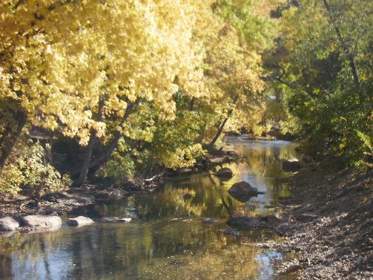
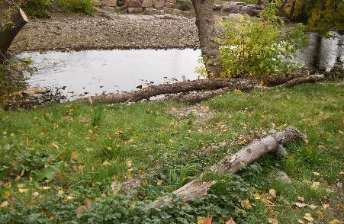
Habitat features
American fisheries society – Co/Wy chapter annual meeting feb 26-28 2019
Boulder Clusters
Floodplain Roughness Features
On-shore Boulder/log Clusters
Robust Planting Plan
Notes:
Boulder clusters and pockets were assessed during the aquatic surveys as important features to incorporate in the design

Slide 29

QUESTIONS?
Notes:
Site assessment methods
Self- Mitigating by Restore historic footprint and functions
Restores stable geomorphic dimensions, pattern, and profile
Maximizes use of wood structures
Preserves wetlands at hyporheic zone at reservoir mouth
Enhances sport fishery
Incorporates landscape design elements to restore recreational elements and facilitate concentrated use access points

Slide 30
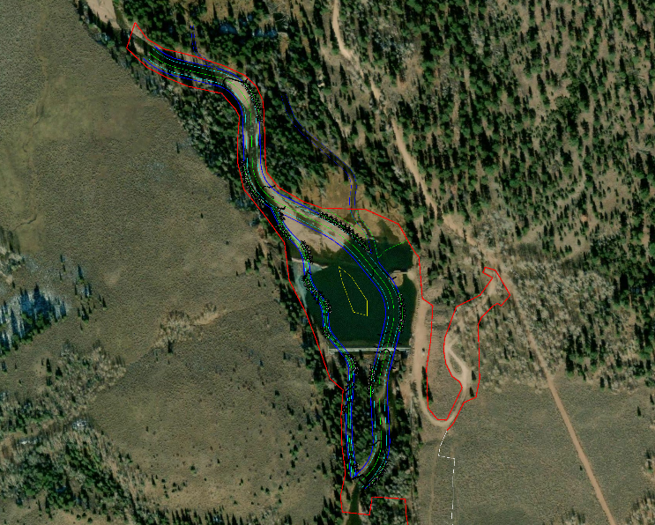
American fisheries society – Co/Wy chapter annual meeting feb 26-28 2019
Notes:
I think an important aspect of the design is maintaining the existing side channel, spring fed wetlands at the head of the reservoir.
The restore channel and large meander bend at the head of the reservoir accomplishes this and maintains the hyporheic zone through the valley floor.
Of course the FS habitat report emphasized the best habitat is within side channels that is why they really wanted to mimic the historic valley floor with a main channel and side channel --even though David B was reluctant at first because less risk to design for a single thread.

Slide 31
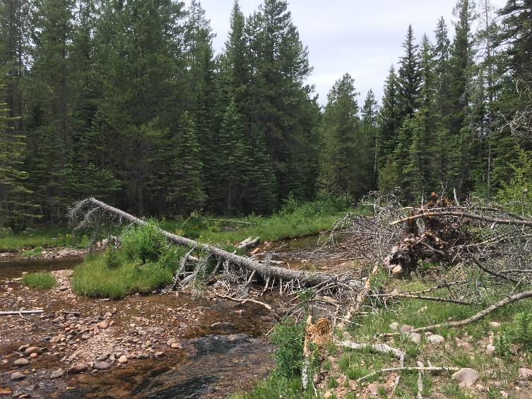
American fisheries society – Co/Wy chapter annual meeting feb 26-28 2019

Slide 32
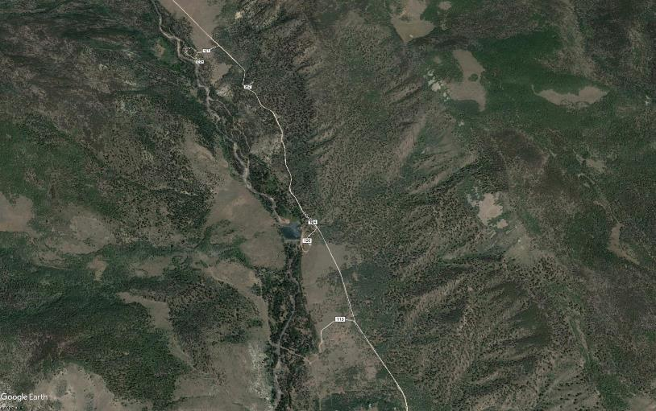
Stream restoration
American fisheries society – Co/Wy chapter annual meeting feb 26-28 2019

Slide 33
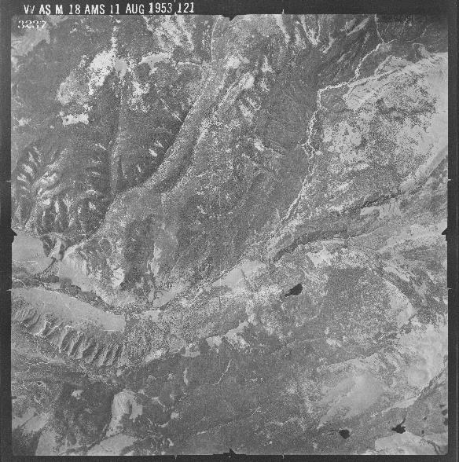
American fisheries society – Co/Wy chapter annual meeting feb 26-28 2019

