Slide 1
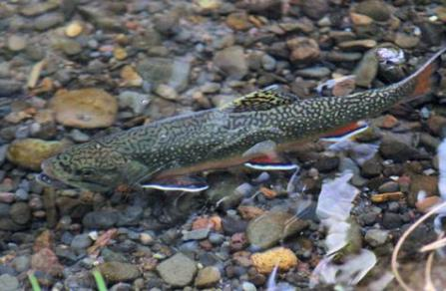
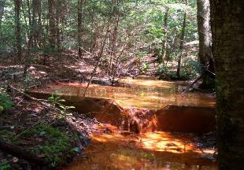
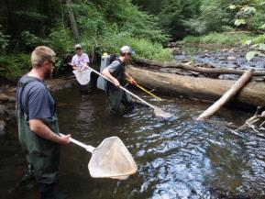
An Evaluation of Biological and Chemical Improvements at Various Spatial Scales in the West Branch Susquehanna River Watershed, Pennsylvania
Shawn Rummel
Lead Science Advisor
Trout Unlimited, Northeast Coldwater Habitat Program
Coauthors: Amy Wolfe, Rachel Kester, Kathleen Lavelle, and Allison Lutz

Slide 2
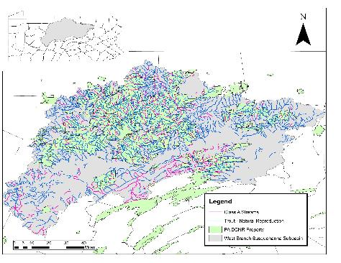
West Branch Susquehanna River Watershed
12,090 miles of streams within subbasin
Warm and coldwater fisheries
5,070 miles support natural trout reproduction (42%)
1,090 miles of Class A Trout water (>30 kg/ha)
Approx. 50% of watershed area is public (state forest or state parks)

Slide 3
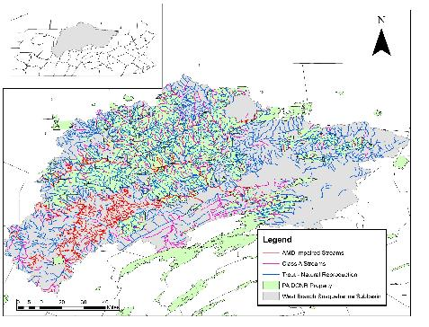
West Branch Susquehanna River Watershed
12,090 miles of streams within subbasin
Warm and coldwater fisheries
5,070 miles support natural trout reproduction (42%)
1,090 miles of Class A Trout water (>30 kg/ha)
Approx. 50% of watershed area is public (state forest or state parks)
1,200 miles of AMD impaired waters (PA DEP)

Slide 4
Impact of AMD on Aquatic Ecosystems
Water Quality
Decreased pH
Increased metal concentrations: Fe, Al, Mn, etc.
Habitat
Increased sedimentation to streams from abandoned mine lands
Precipitating metals often coat substrate (limits benthic macroinvertebrate habitat and fish spawning habitat)
Benthic Macroinvertebrates & Fish
Loss of pollution sensitive taxa
Decreased growth, reproduction, or death
Increased avoidance behavior or movements for mobile organisms
Dissolved metals are toxic to aquatic life
High metal concentrations interrupt respiration in aquatic organisms
Isolation of populations due to water quality barrier

Slide 5
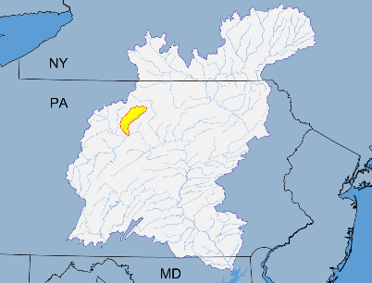
Kettle Creek Watershed
90% watershed, 224 sq mi, is designated as Exceptional Value water quality (largest in PA)
Kettle Creek mainstem is one of PA’s most heavily fished stocked trout streams, while tributaries contain some of PA’s most well known native brook trout streams
Although completely underlain by Marcellus shale, majority of watershed aside from very headwaters will not be developed due to natural gas storage deep wells in the Oriskany sandstone

Slide 6
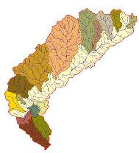
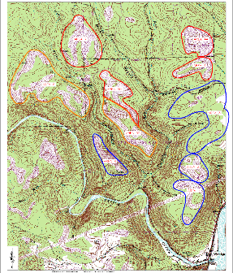
Kettle Creek Watershed AMD
Unfortunately 12 miles AMD pollution and 1,087 acres of abandoned mines in lower section of watershed
Deep and surface mines in the Upper and Lower Kittanning coal seams
pH 2.5 – 3.5
Acidity 200 – 600 mg/L
Fe 20 – 50 mg/L
Al 20 – 70 mg/L

Slide 7
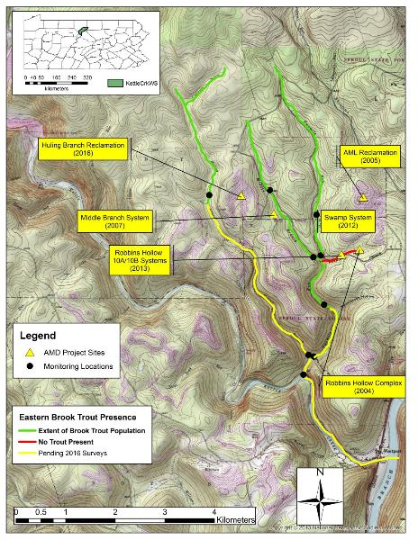
Kettle Creek Restoration Projects (Since 2004)

Slide 8
Middle Branch Fishery Survey Data
No Data
No Data
No Data
No Data

Slide 9
Benthic Macroinvertebrate Biological Metrics – Middle Branch
 | DWS Treatment |  |  |  |  |  |  | UPS Mean
 | 2008 | 2010 | 2012 | 2013 | 2014 | 2015 | 2017
Total Taxa Richness | 3 | 7 | 15 | 21 | 27 | 14 | 10 | 19.5
EPT Taxa Richness | 1 | 6 | 8 | 9 | 13 | 7 | 6 | 10
% Sensitive Individuals | 33.3 | 97.8 | 55.6 | 40.0 | 61.0 | 69.8 | 80.3 | 55.7
PA IBI Scores
No Data

Slide 10
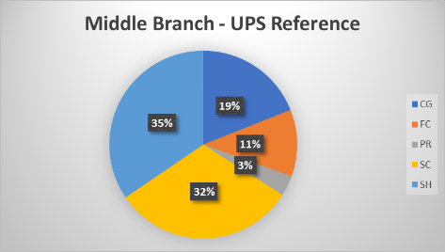
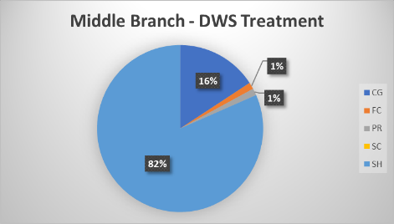
Functional Feeding Groups
Collector-Gatherers (CG)
Collect Fine Particulate Organic Matter (FPOM)from stream bottom
Filterers-Collectors (FC)
Collect FPOM from water column using filters
Predators (PR)
Feed on other consumers
Scrapers (SC)
Consume algae and associated material
Shredders (SH)
Consume leaf litter and coarse organic matter

Slide 11
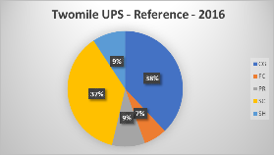
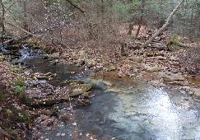
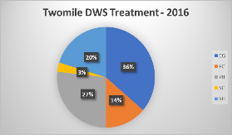
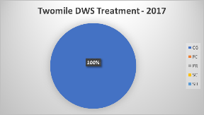
Resiliency of AMD Restored Systems?
October 2016 – High Flow Event
Modest Brook Trout population present in Fall 2017 Surveys of Twomile Run
pH = 3.4
Alk = 0 mg/L
Acid = 122 mg/L
Al = 13.5 mg/L
No Brook Trout found in surveys following event
IBI = 57
Taxa Richness = 22
% Sensitive = 31.8%
IBI = 27.7
Taxa Richness = 10
% Sensitive = 4.3%

Slide 12
West Branch Susquehanna River Watershed
12,090 miles of streams within subbasin
Warm and coldwater fisheries
5,070 miles support natural trout reproduction (42%)
1,090 miles of Class A Trout water (>30 kg/ha)
Approx. 50% of watershed area is public (state forest or state parks)
1,200 miles of AMD impaired waters (PA DEP)

Slide 13
AMD Treatment Systems and Reclamation Projects
Approximately 80 treatment sites throughout the West Branch
What impact are they having at a large scale?
Prior to 2009, last comprehensive water quality survey of the watershed was completed in the 1970’s

Slide 14
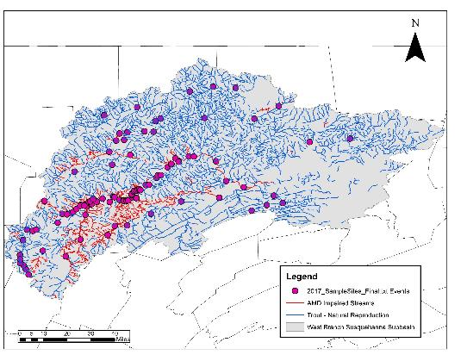
West Branch Susquehanna Recovery Benchmark II (2017-2019)
Objectives:
Replicate 2009 study; expand to 109 sample sites including reference sites
Prioritization of future projects
Establish long-term monitoring strategy for West Branch
Develop citizen science AMD monitoring guide
How has treatment impacted the watershed?
Can benthic macros be used as a measure of success?
Threshold criteria for restoration success?
Timeline for recovery?

Slide 15
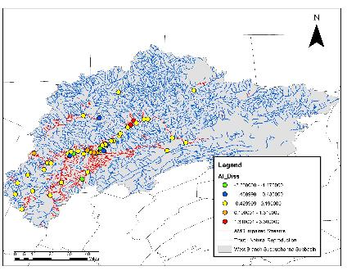
Water Chemistry – Change between 2009 & 2017; Low Flow Samples
pH
Dissolved Al
Mean Low flow pH: 2009 = 5.18; 2017= 5.46
Range = 2.8 - 8.0

Slide 16
Benthic Macroinvertebrate Preliminary Results
Biological Metric (Mean) | 2009 | 2017 | Reference
Total Individuals | 35.24 | 103.59 | 206.63
Taxa Richness | 7.93 | 18.20 | 35.34
EPT Taxa Richness | 2.18 | 4.76 | 16.77
Beck’s Index | 4.43 | 9.16 | 32.91
Hillsenhoff Index | 4.60 | 4.71 | 2.68
Shannon Diversity Index | 1.44 | 2.13 | 2.73
IBI | 33.02 | 44.86 | 86.10

Slide 17
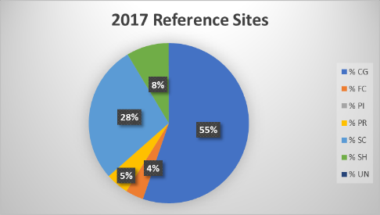
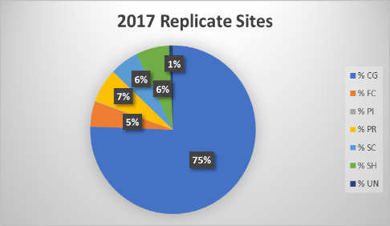
Functional Feeding Groups
Collector-Gatherers (CG)
Collect Fine Particulate Organic Matter (FPOM)from stream bottom
Filterers-Collectors (FC)
Collect FPOM from water column using filters
Predators (PR)
Feed on other consumers
Scrapers (SC)
Consume algae and associated material
Shredders (SH)
Consume leaf litter and coarse organic matter

Slide 18
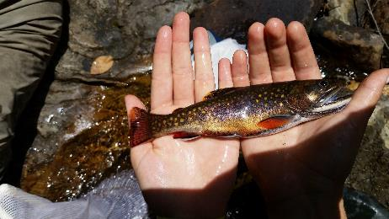
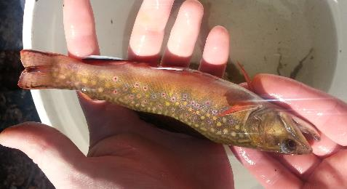
Fishery Response
Surveys to be completed on the mainstem of river in Summer 2019
Since 2010, fishery surveys have documented 401 miles of wild trout streams in the watershed, an increase of 216 miles.
27.8 miles of the mainstem West Branch Susquehanna River now supports wild trout – downstream of an active treatment system
This section is now managed as catch & release.

Slide 19
Next Steps
Compile monitoring data on treatment systems – determine capacity of treatment
Quantify chemical and biological improvements in watershed due to treatment
Analyze aquatic community composition across environmental gradient – water quality, habitat, land use, etc.
Thresholds in community metrics and/or taxa to help guide restoration objectives and goals
Can macroinvertebrates and/or fishery communities be used to assess progress/success of restoration along gradient?
Establish a general timeline for recovery of AMD streams from sites with long-term monitoring
How long until restoration sites mimic reference sites?
Establish a probabilistic long-term monitoring strategy for the West Branch Susquehanna River watershed

Slide 20
Shawn Rummel
Lead Science Advisor
Northeast Coldwater Habitat Program
Lock Haven, PA
shawn.rummel@tu.org
814-360-2633
Thank you!

