Slide 1
Streamflow Variability and Treatment System Effectiveness in a Changing Climate
Dr. Natalie Kruse Daniels
Zachary Matthews

Slide 2
Trends in Precipitation and Streamflow

Slide 3
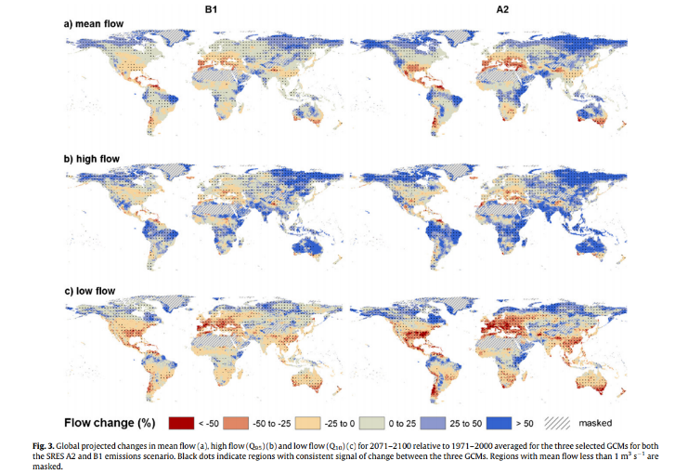
Global Trends in Streamflow

Slide 4
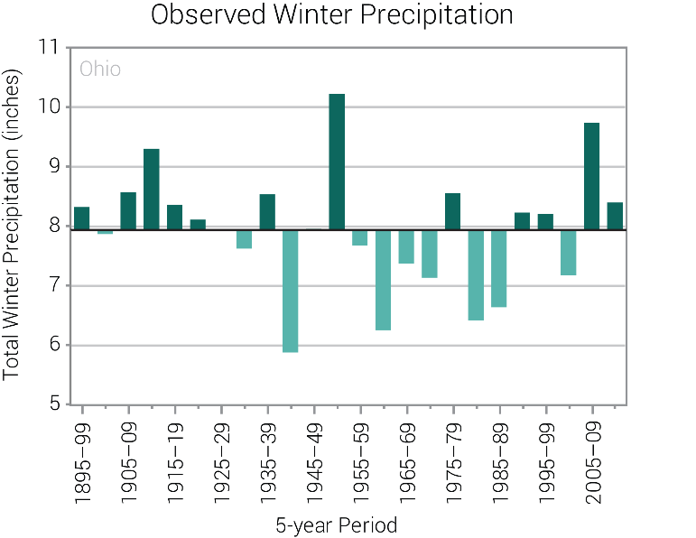
Observed Trends in Ohio

Slide 5
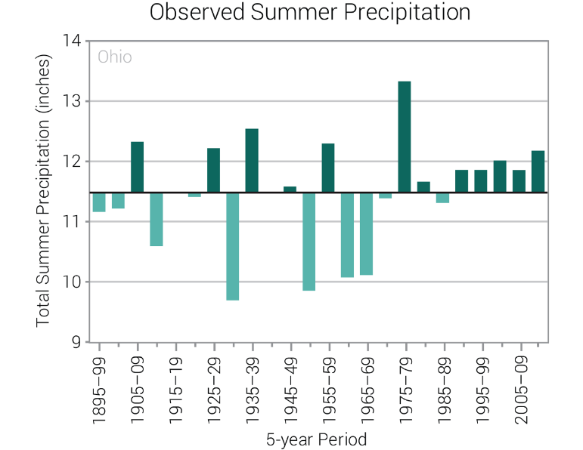
Observed Trends in Ohio

Slide 6
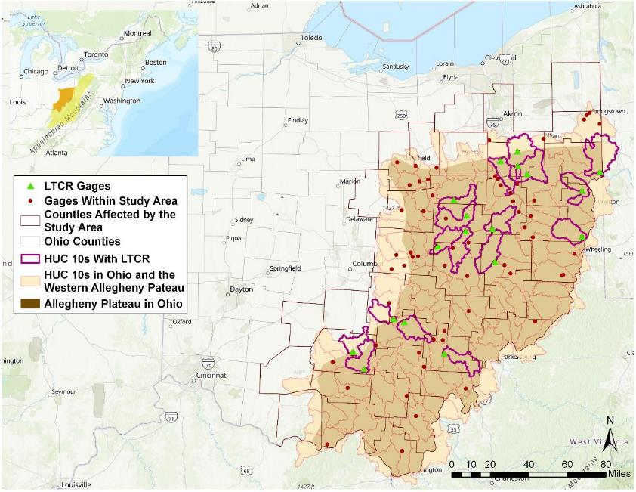

Slide 7
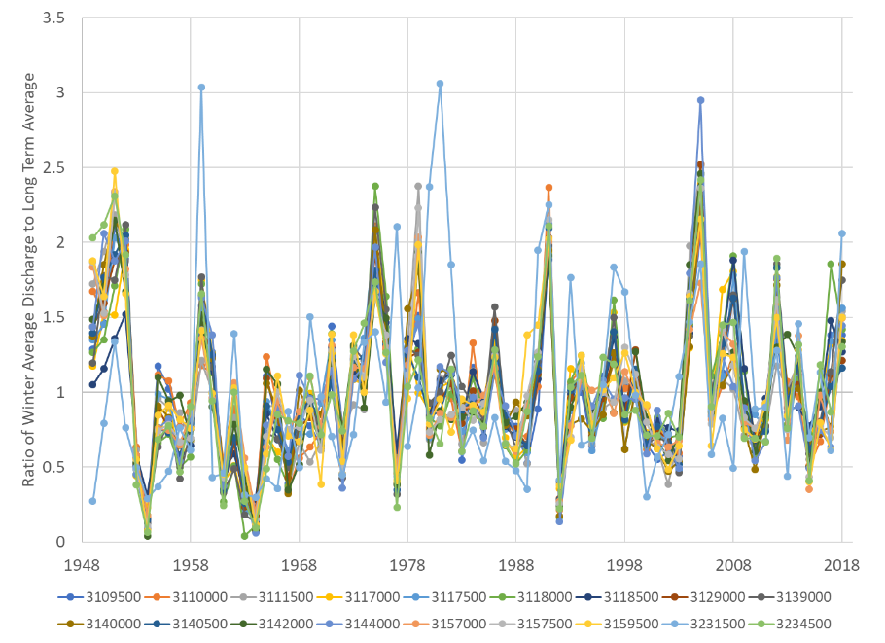

Slide 8
Wet Winters
Dry Winters

Slide 9
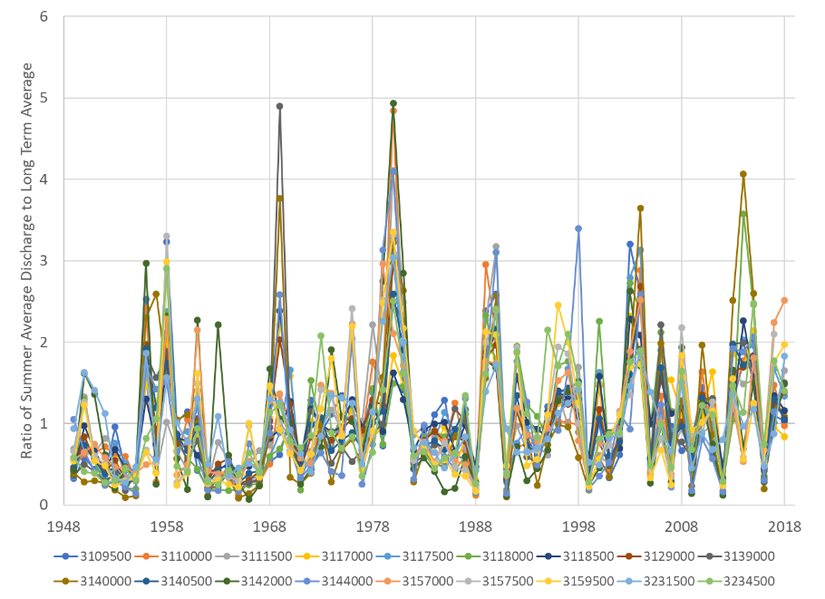

Slide 10
Wet Summers
Dry Summers

Slide 11
Water Quality Trends

Slide 12
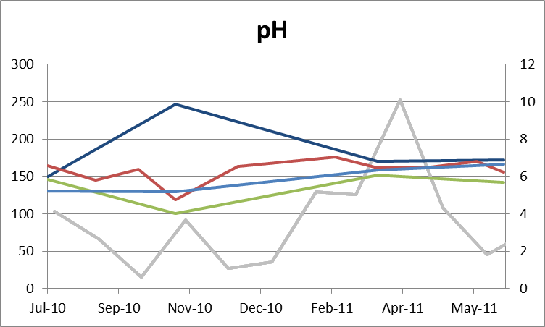
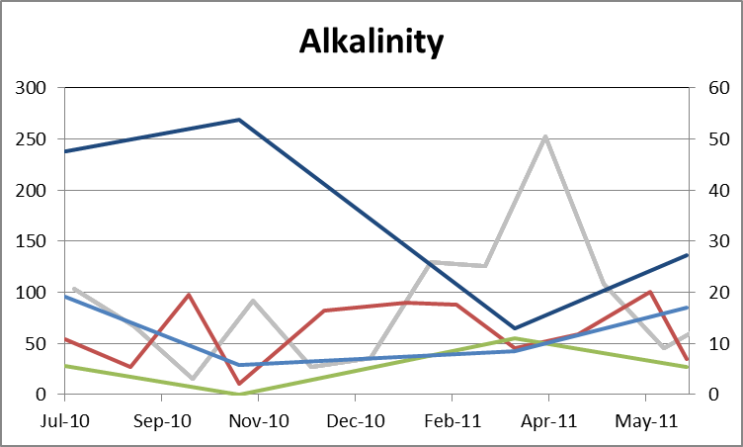
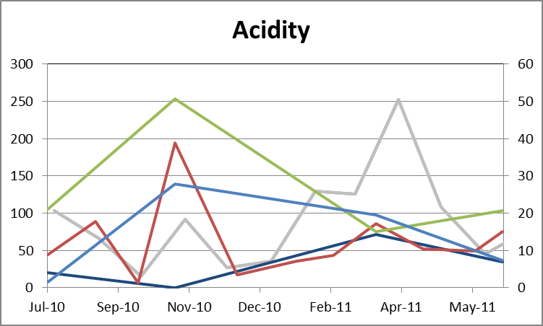
Impaired Zone Chemistry influenced by Precipitation
Upstream → Downstream
Dark Blue = HF130
Blue = HF190
Green = HF095
Red = HF090

Slide 13
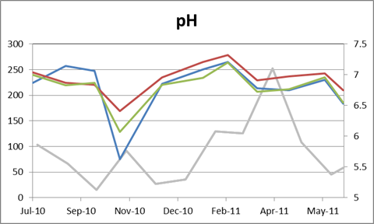
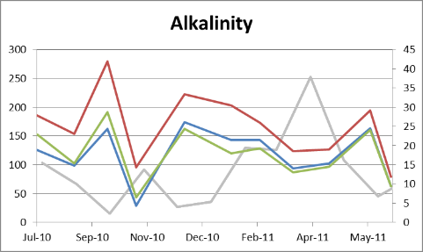
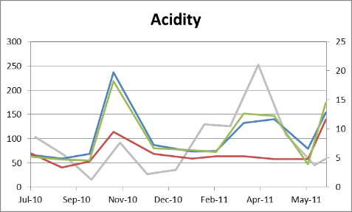
Transition Zone Chemistry influenced by Precipitation
Upstream → Downstream
Blue = HF075
Green = HF060
Red = HF045

Slide 14
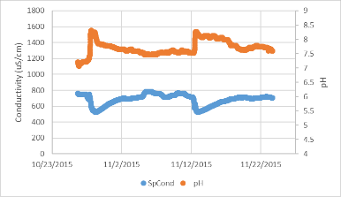
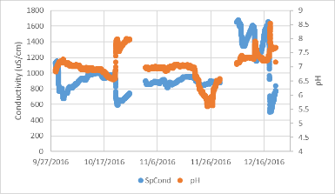
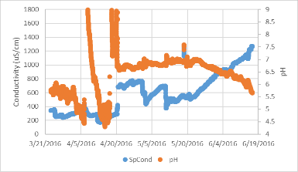
Seasonal water quality 4.5 km downstream from doser

Slide 18
Long Term Chemical Record

Slide 19
Long Term Chemical Record

Slide 20
Treatment Success and Flow

Slide 21
Measuring Treatment Success
Stoertz Water Quality Evaluation Method
Compares log contaminant loading at varying log discharge values normalized by mean annual discharge
Cases: Carbondale Doser, Jobs Doser, Flint Run (reclaim, SSLB, SAPS, wetlands), East Branch (reclaim, SSLBs)

Slide 22
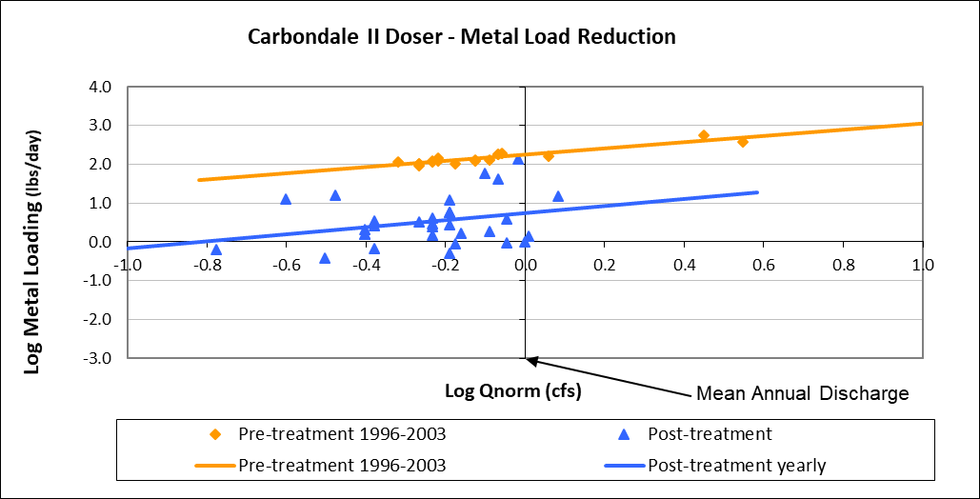
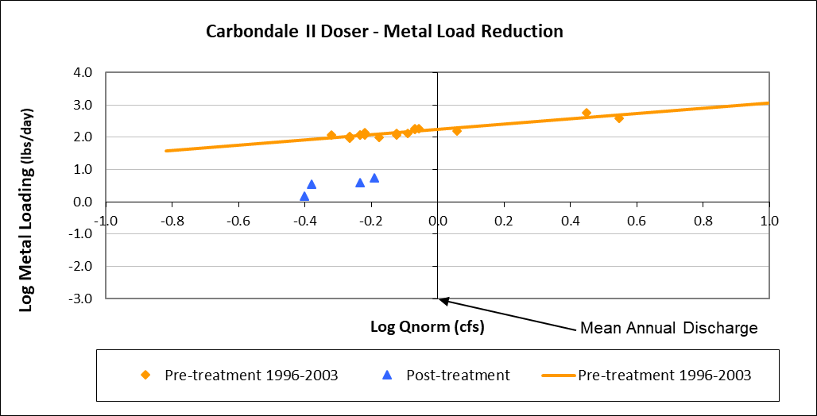
2016-2018 data

Slide 23
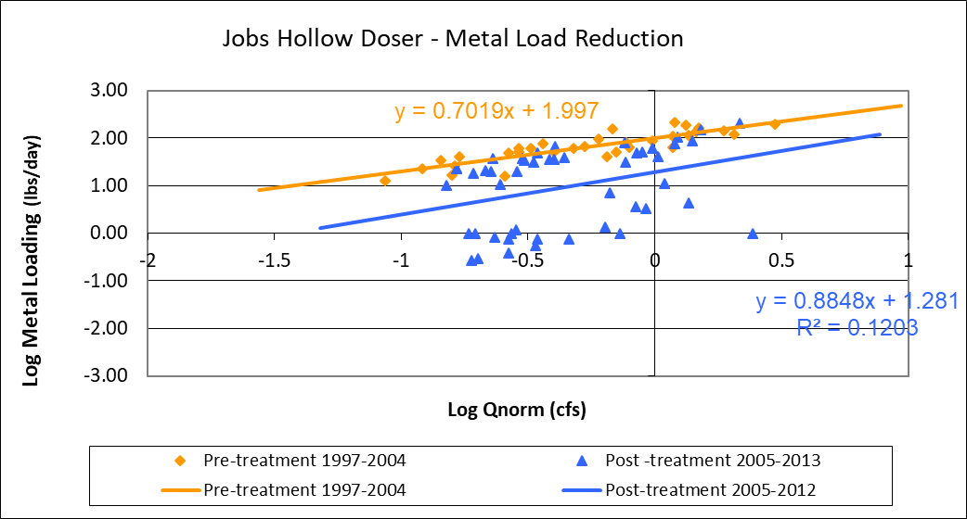
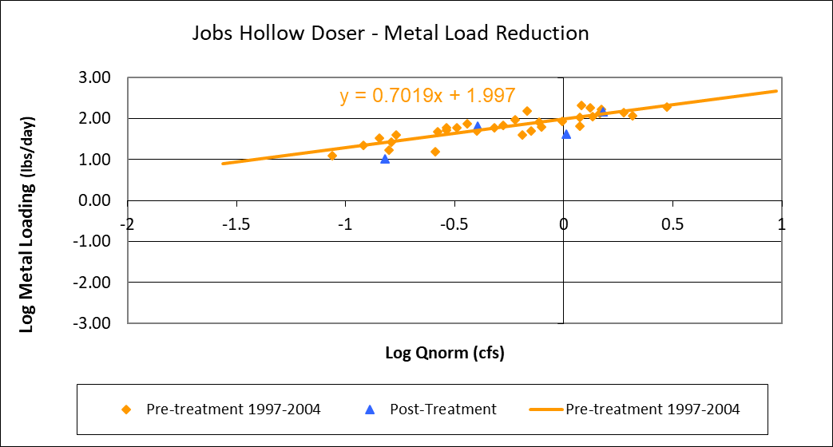
Data from ‘05-’06 and ‘13-’14
2016-2018 data

Slide 24
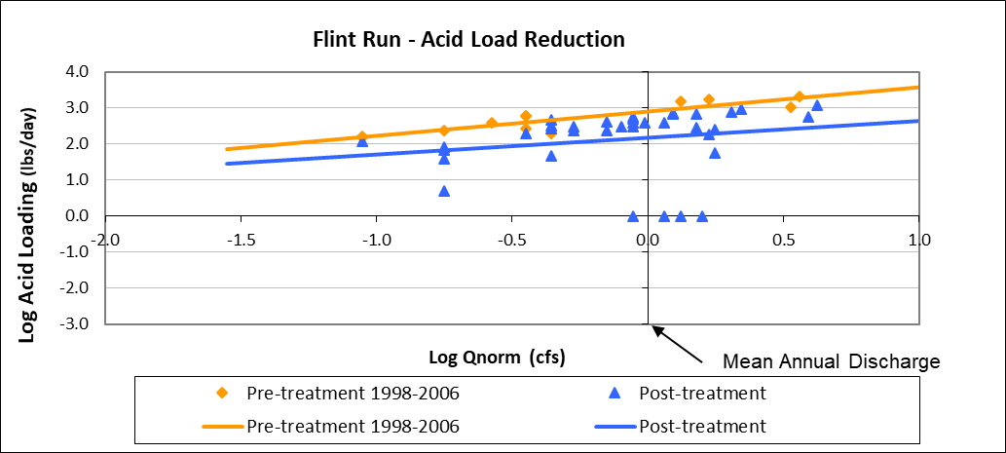
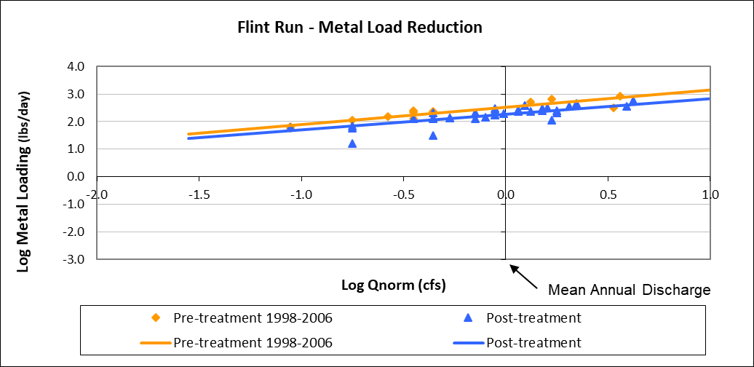
2006

Slide 25
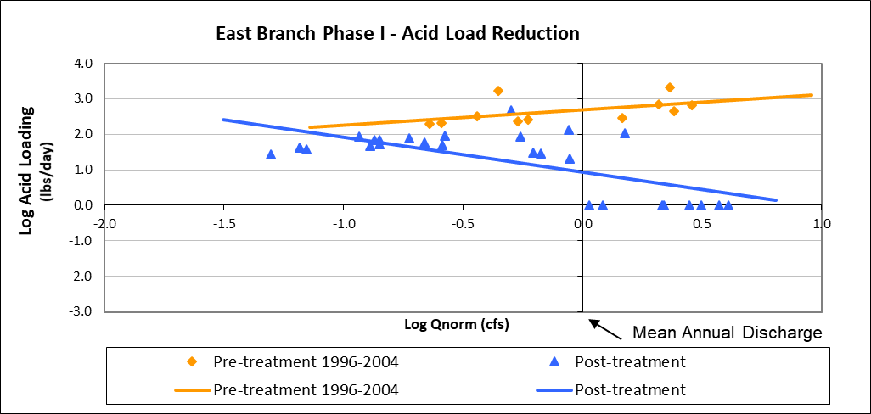
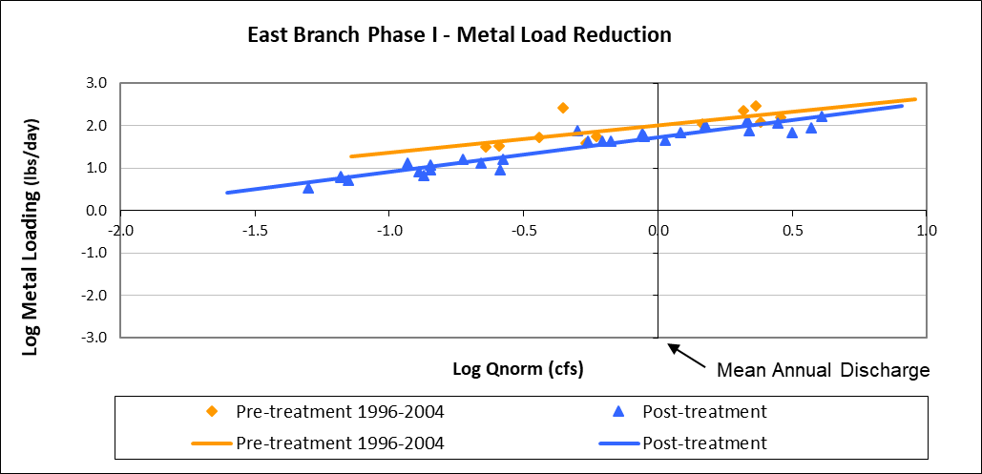

Slide 26
Climate Impacts on Mine Drainage and Mine Water Treatment

Slide 27
Climate and Mine Drainage
Recent assessment in Wayne National Forest – aligned with Forest Plan Revision
Regional climate models suggest:
Greater overall precipitation volumes
Higher intensity storms
Higher intensity droughts
Higher water temperatures

Slide 28
Climate and Mine Drainage
Mine drainage may become a greater part of reliable base flow and maintenance of water temperature
‘Flushing’ behaviors from varying hydrology, changing depth of mine pools change source chemistry
Greater transportation of mineral rich sediments
Nutrient poor systems

Slide 29
Climate and Mine Drainage
Stress on treatment system dams and other infrastructure
Low flow periods stressing source water supplies
Greater importance of subsidence closure to restore surface hydrology

Slide 30
Case Study of Subsidence Closure
Representative of low flow, low recharge scenario

Slide 31
Majestic Study Site

Slide 32
Majestic Acid Regression
60.5% reduction in acid load

Slide 33
Majestic Metal Regression
67.19% reduction in metal load

Slide 34
Change in Hydrology = Change in Chemistry
Increased acid and metal concentrations due to greater exposed reactive mineral
Decreased discharge due to lower inflow
Increases in concentrations overcome by 72% reduced flow to result in overall load reductions

Slide 35
Conclusions
Climate change is driving changing hydrology
Hydrology and mine water chemistry and volume are strongly related
Priority evaluation and consideration of:
Infrastructure safety and resilience
Change in treatment needs with changing hydrology
Re-prioritize projects that are resilient to climate change

Slide 36
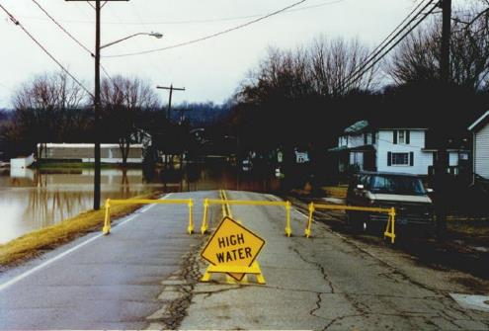
Acknowledgements
Appalachian Watershed Research Group
Wayne National Forest - Forest Plan Revision Team
Danny D’Amore
Kim Miller
Zeb Martin
Nora Sullivan
Rebekah Korenowsky
Lisa DeRose
Elizabeth Migliore

